Slide 1
NE 763: Advanced Reactor Materials
Fall 2026
Dr. Benjamin Beeler

Slide 2
Paper Presentation Assignment
A topic related to advanced reactor materials will be assigned and the student will present a presentation summarizing the topic area.
  slightly changed… I am allowing you to choose from a list. This list is on the moodle. Put your name next to a topic that does not overlap with your research. I can change your topic if I feel like it.
Students will be evaluated on the technical content and the presentation/organization of the content.
Presentations occur in person.
Aim for 15 minutes. Will try to do 4 or 5 per class.
Distance students will upload a zoom recording. All students upload their slides.
Slides/Recordings are due by midnight Oct. 21, and presentations will start on Oct. 22
Five weeks to complete, should be plenty of time

Slide 3
Last Time
Solid fission product swelling
  fuel chemistry different than oxide fuels: solid solution elements, metallic precipitates, noble gases; many FP precipitates associated with porosity or the Na
  net 1.5%-ish swelling per %FIMA
FCCI
  a key life-limiting phenomenon in metallic fuels
  wastage of cladding and formation of low Tmelt phases
  adding Zr decreases FCCI, and impurities can form a Zr rind
  Fe diffuses into the fuel, forms U(Pu)6Fe type phases
  Nd/Ce diffuse into the cladding, form (Fe,Cr)17(Nd,Ce)6 type phases
  FCCI is localized, and increases with T and with burnup

Slide 4
Metallic fuel performance modeling

Slide 5
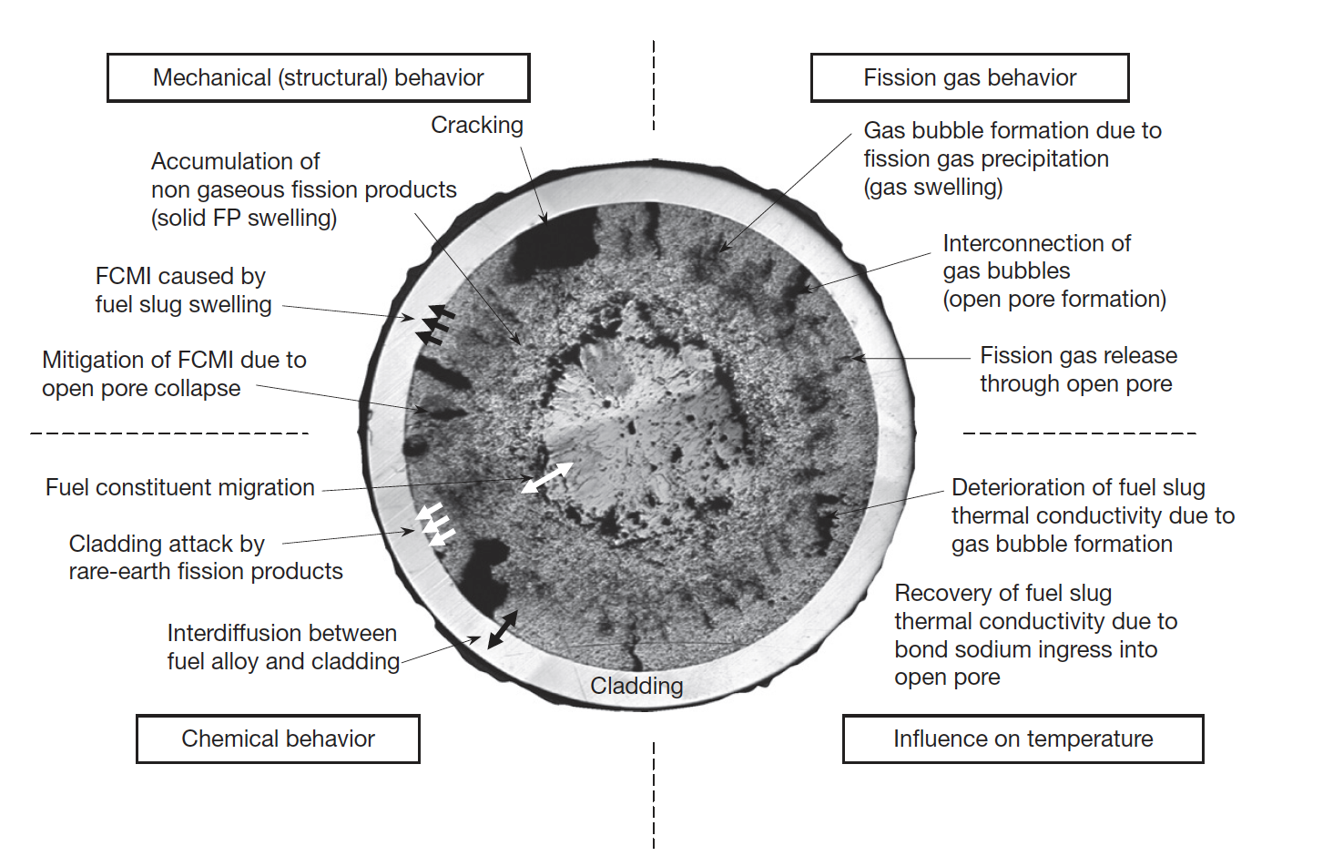
Metallic Fuel Phenomena

Slide 6
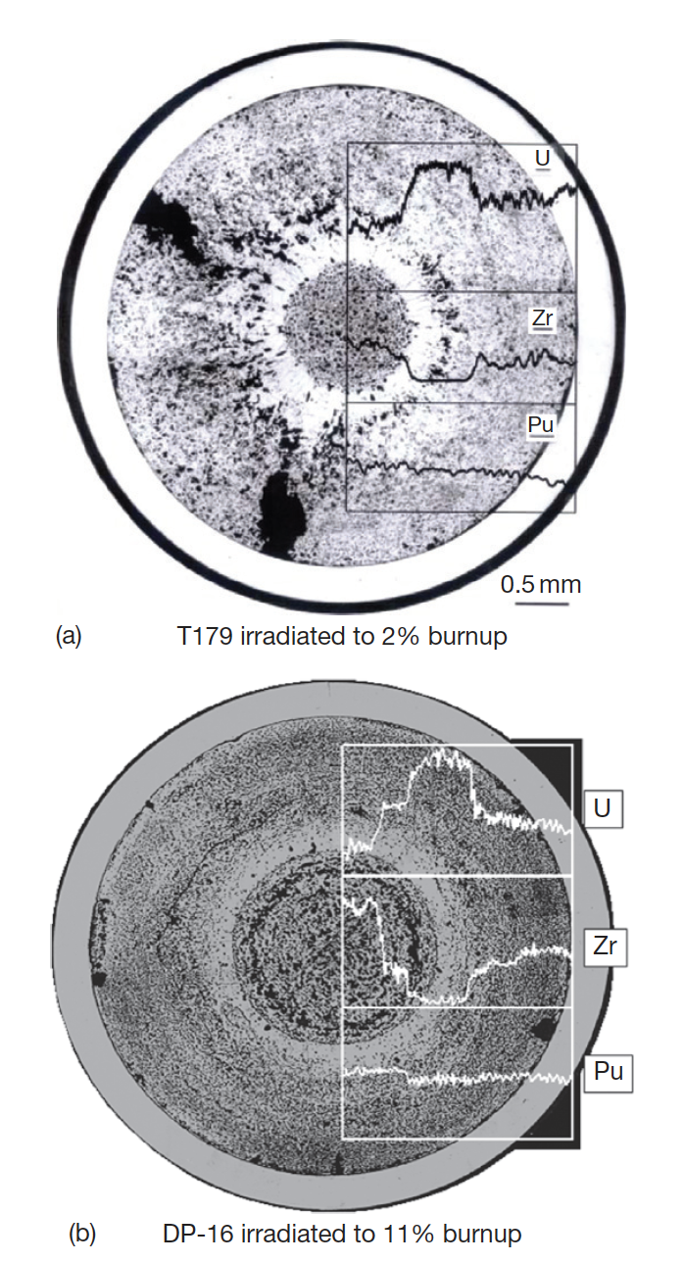
Constituent Redistribution Models
Constituent redistribution is driven by:
  temperature gradients in the fuel,
  solubility gradients in a phase and phase boundaries,
  additional chemical potentials applied by fuel– cladding gap and cladding
Results in three concentric zones, namely, a Zr-enriched central zone, a Zr-depleted and U-enriched intermediate zone, and a slightly Zr-enriched zone on the outer periphery
Migration quickly levels off early in life after a new distribution settles

Slide 7
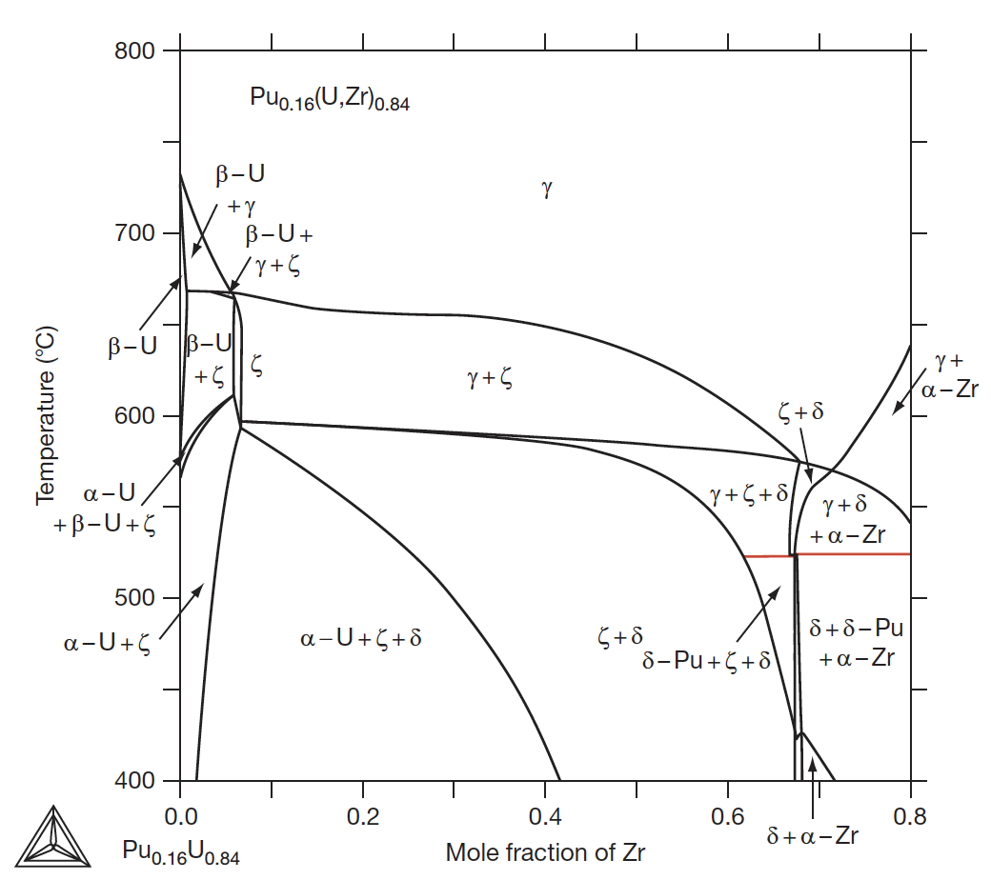
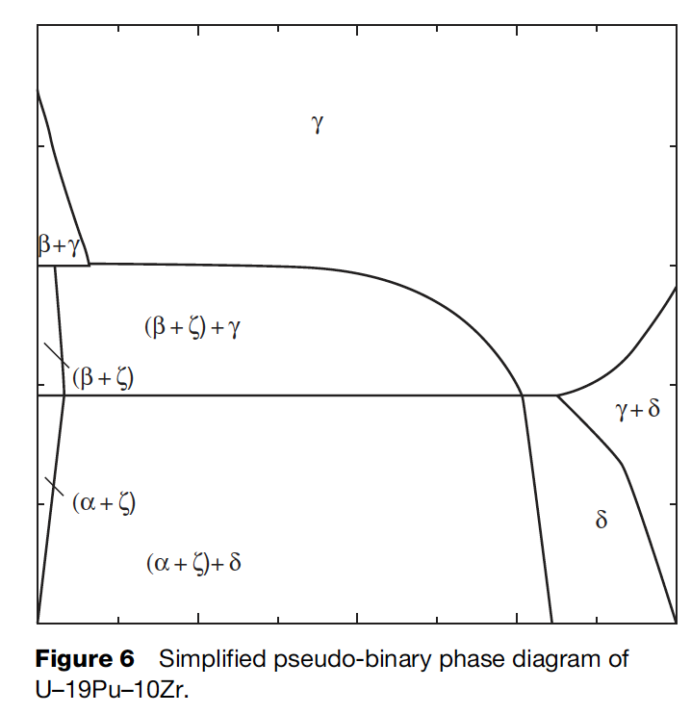
Constituent Redistribution Models
While ternary phase diagrams exist, their accuracy is suspect, and simplified pseudo-binary phase diagrams can be more easily implemented, and removes complexities associated with largely unknown phases
When applied to a fuel with different Pu content, the phase diagram must be modified accordingly

Slide 8

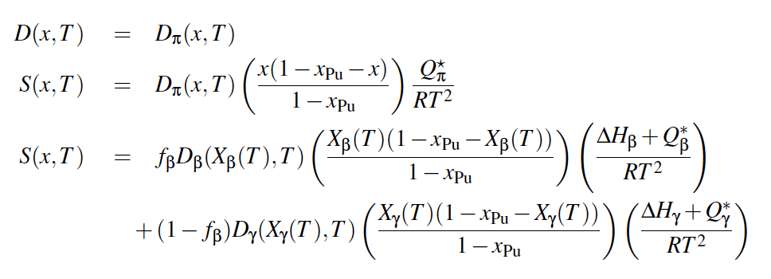
Constituent Redistribution Models
Using the calculated phase fractions, the Fickian and Soret diffusion coefficient are determined
Artificial factors are used to set the diffusivity in two-phase regions and to scale diffusivities in each phase
The magnitudes of diffusivities in each phase are largely unknown, and effectively wholly unknown in two-phase regions
BISON Zr Diffusion Model

Slide 9
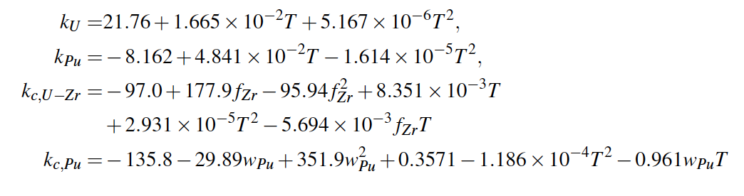
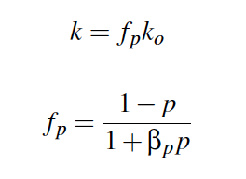
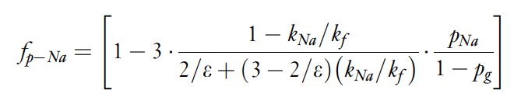
Temperature Predictions
Constituent redistribution relies on accurate temperature profiles
Fuel temperature is affected by the thermal conductivity of the fuel, which in turn is changed by porosity evolution and sodium infiltration, in addition to changes in Zr concentration
BISON thermal conductivity models exist for the distinct species, and account for degradation of thermal conductivity
No phase-specific data exists

Slide 10
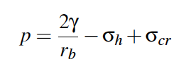
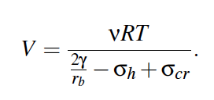

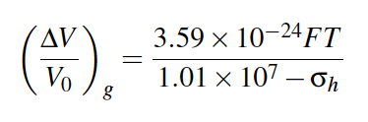
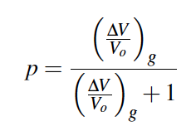
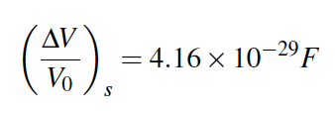
Porosity Predictions
BISON utilizes a simplified model for porosity
The mechanical force balance on an equilibrium bubble can be expressed by the Young-Laplace equation
Making assumptions for creep stress, bubble size, can calculate swelling due to fission gas
Finally, can determine porosity from the swelling
Solid fission products are a function of fission density

Slide 11
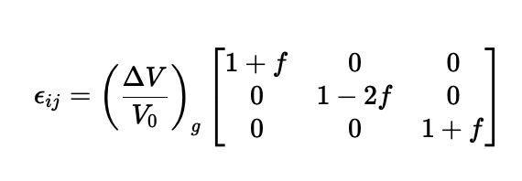
Porosity Predictions
These porosity models don’t incorporate different phases, initial porosity, axial/radial swelling, etc.
These models have been updated slightly to improve code robustness, but still don’t incorporate these critical microstructural phenomena
For example, anisotropic swelling is modeling through a factor, which modifies the swelling into different dimensional strains radially/axially

Slide 12
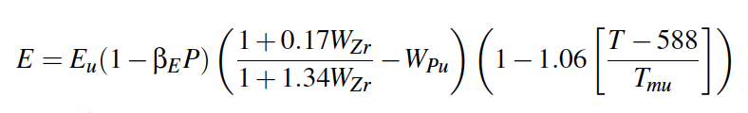
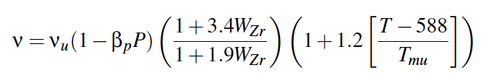
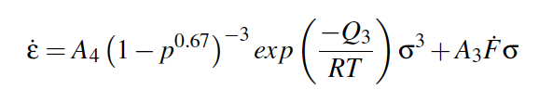


Mechanical Properties
Young’s Modulus
Poisson’s ratio
Creep
Cladding models for HT-9 creep and k_{th}

Slide 13
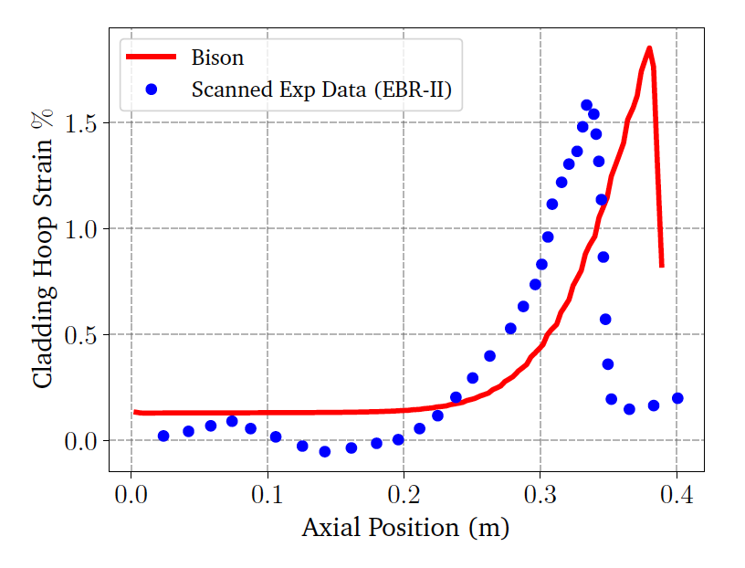
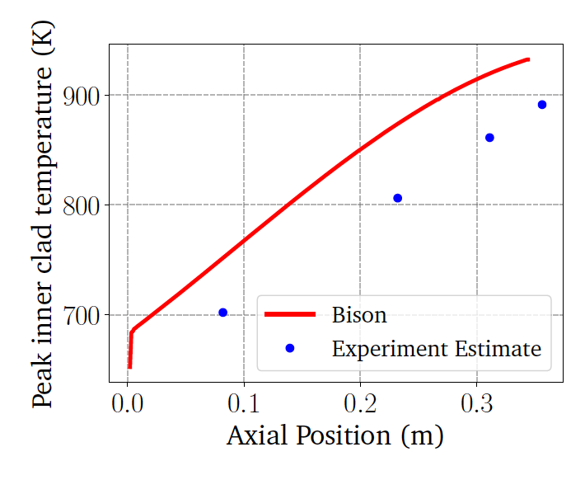
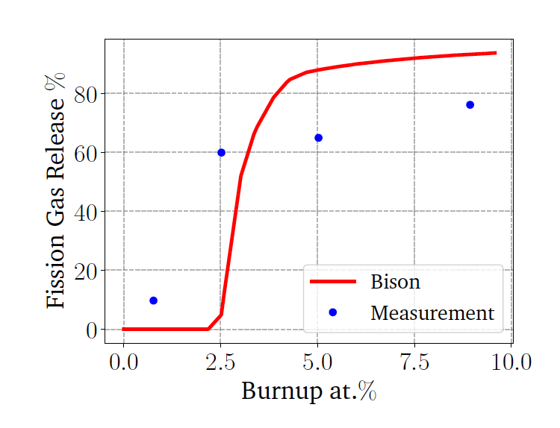
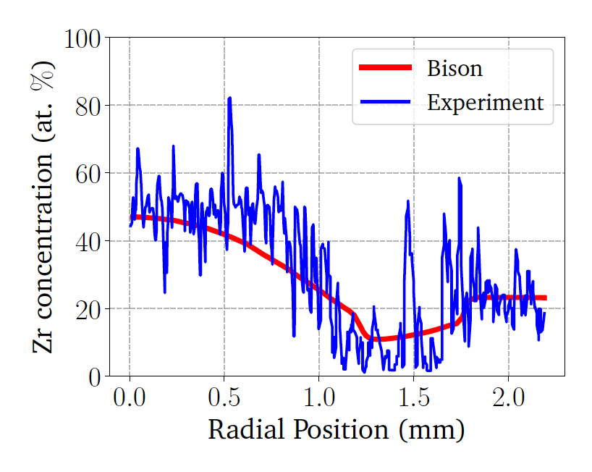
BISON Testing
BISON can handle binary and ternary fuel and compares reasonably well with EBR-II data
Discrepancies are due to inadequate knowledge of materials models, and underlying issues with material descriptions, and code robustness
Development is ongoing, and improvements to swelling models, for example, have been made

Slide 14
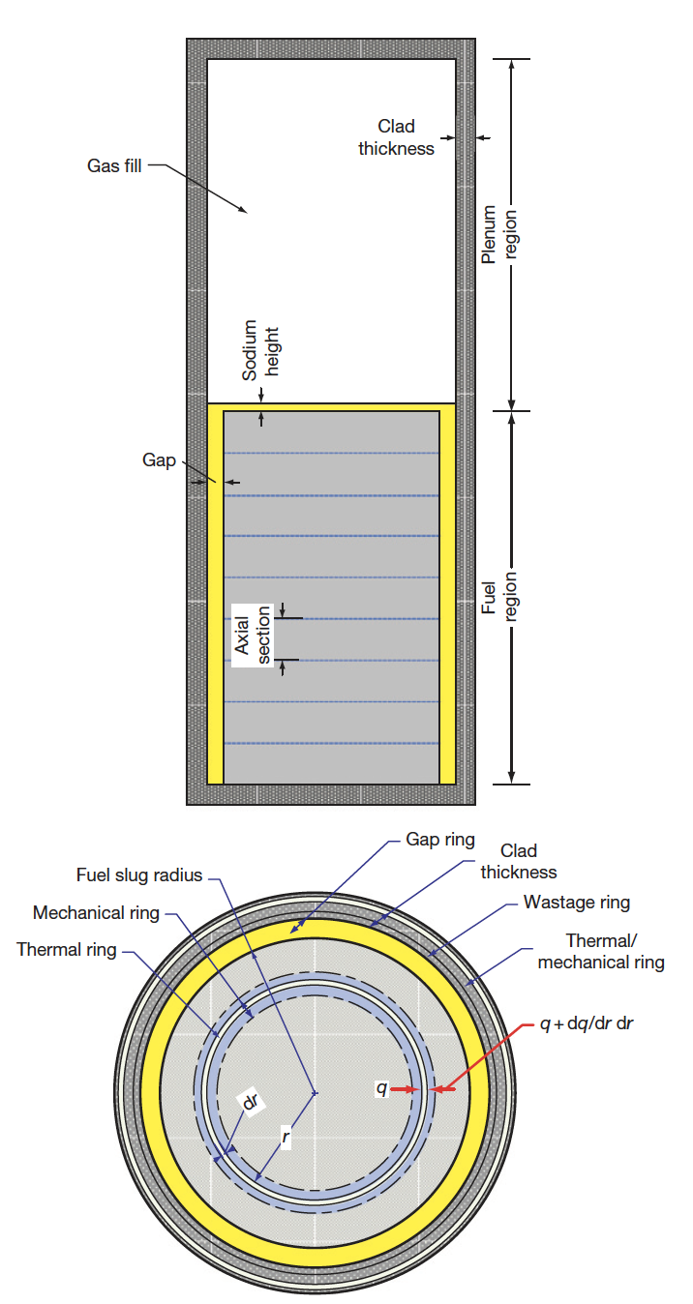
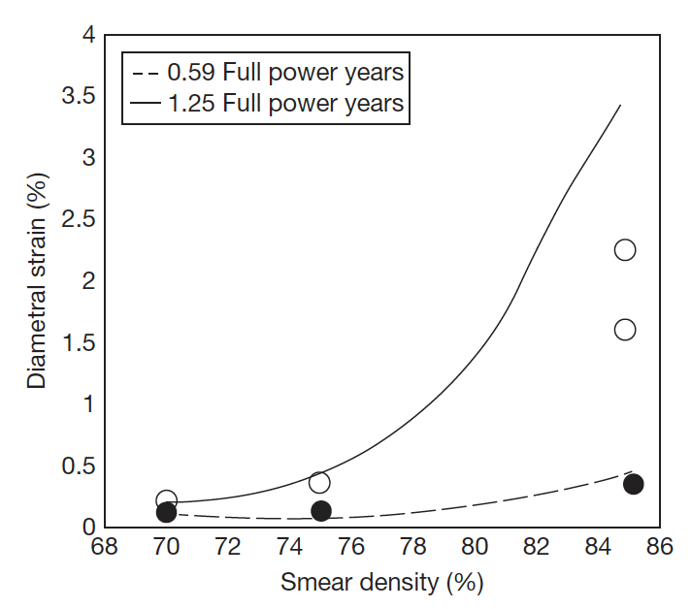
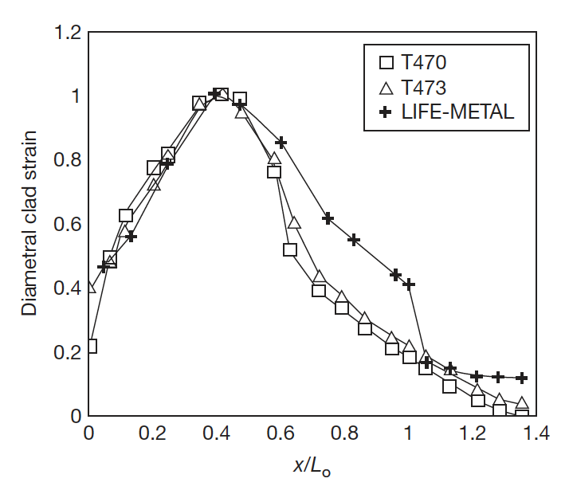
Other Codes
LIFEMETAL
The code has evolved from the LIFE series of codes from ANL that perform steady-state and transient analyses for nuclear fuel
The original code was developed for UO2 and mixed oxide fuels for use in fast reactor systems
The code was developed in association with the IFR and has been extensively used for planning steady state and transient experiments at EBR-II

Slide 15
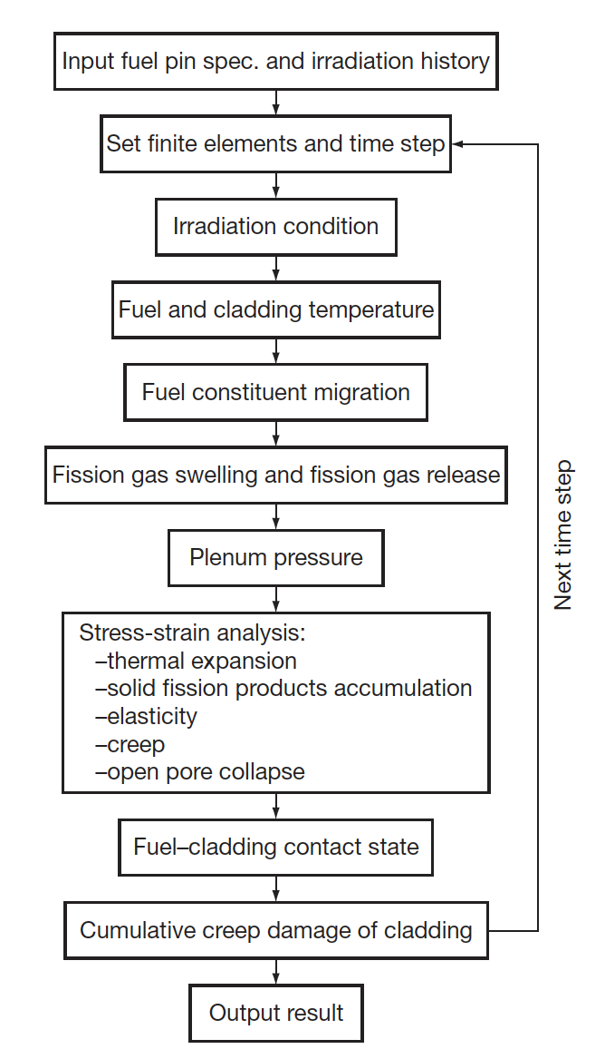
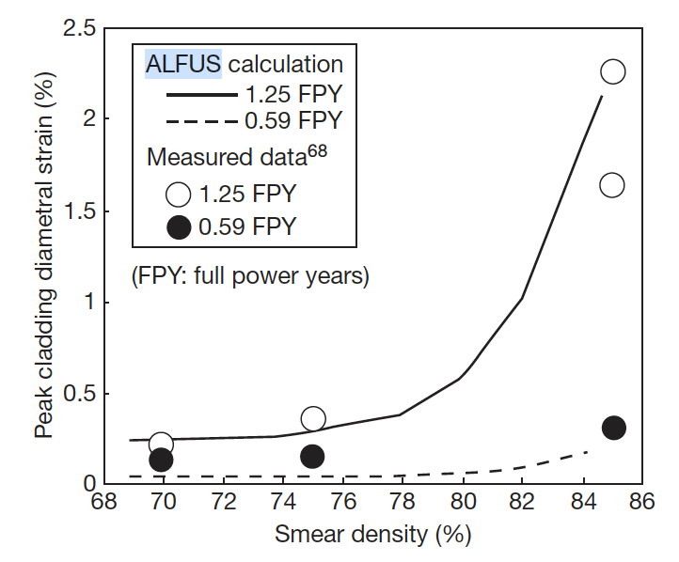
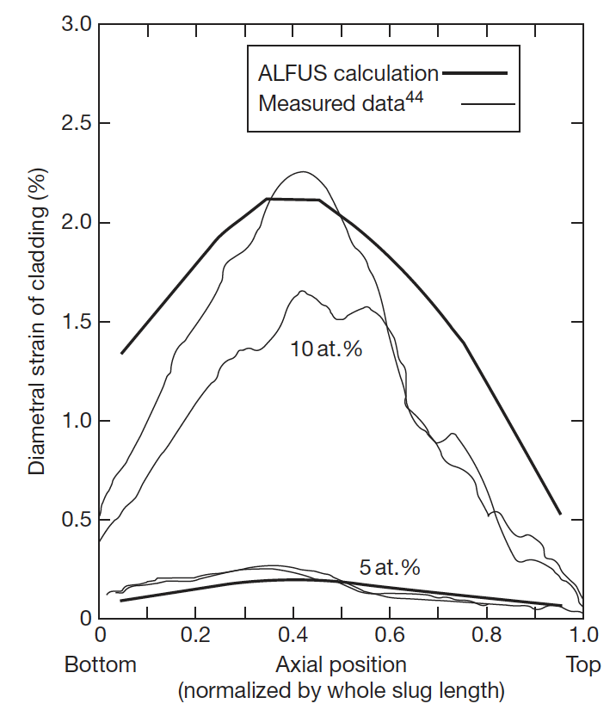
Other Codes
ALFUS
JAEA code that is multiphysics in nature and focuses on the mechanical behavior of the fuel under irradiation
Both LIFE-METAL and ALFUS are capable of simulating metal fuel irradiation behavior to some extent
Both lack different swelling in different radial zone, coupling of redistribution, realistic predictions of FCCI, etc.

Slide 16
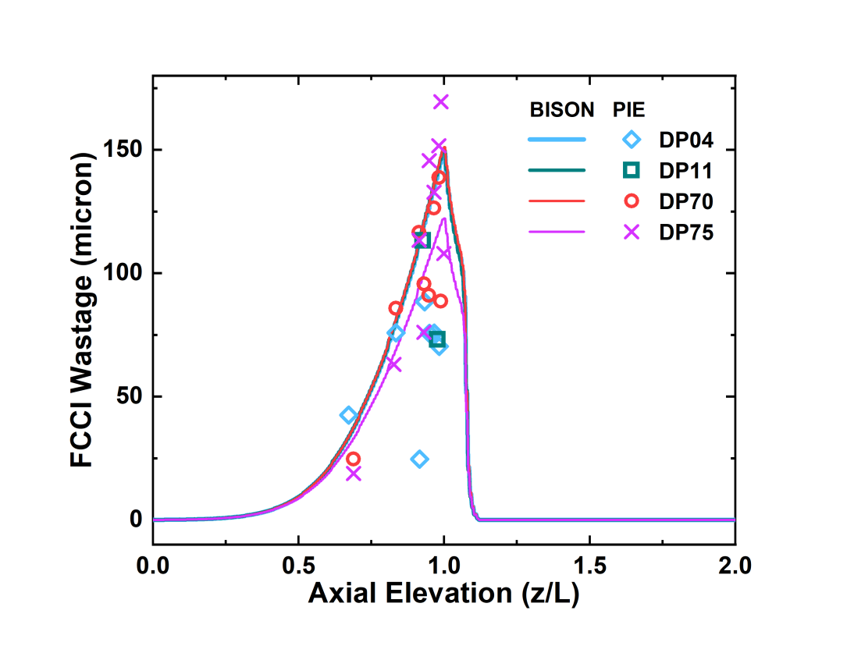
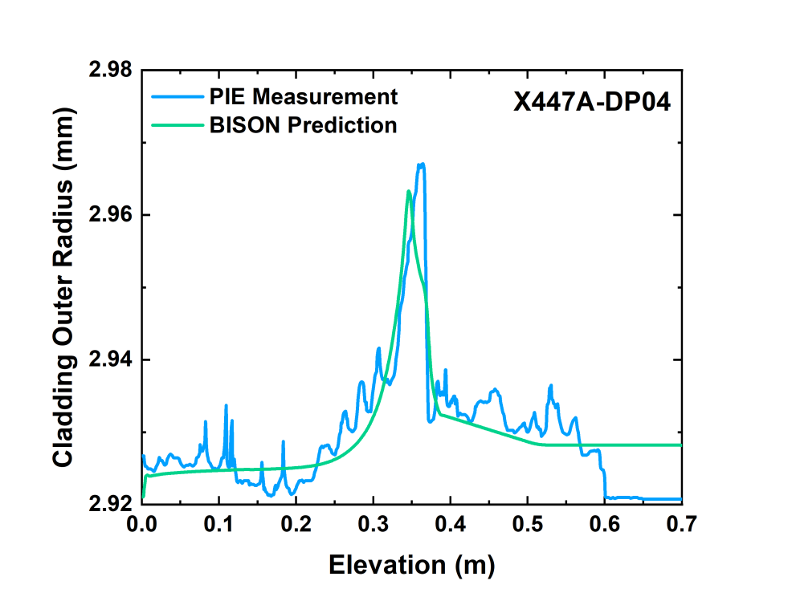
Summary
Fuel performance modeling is relatively underdeveloped for metallic fuels
Lots of the pieces are there… but there is significant uncertainty in most materials models
Still includes ad-hoc corrections and empirical relations based on 2-5 historical experiments
Recent report details current state of knowledge in more depth:
  ANL/CFCT-22/28

Slide 17
Metal fuel fabrication

Slide 18
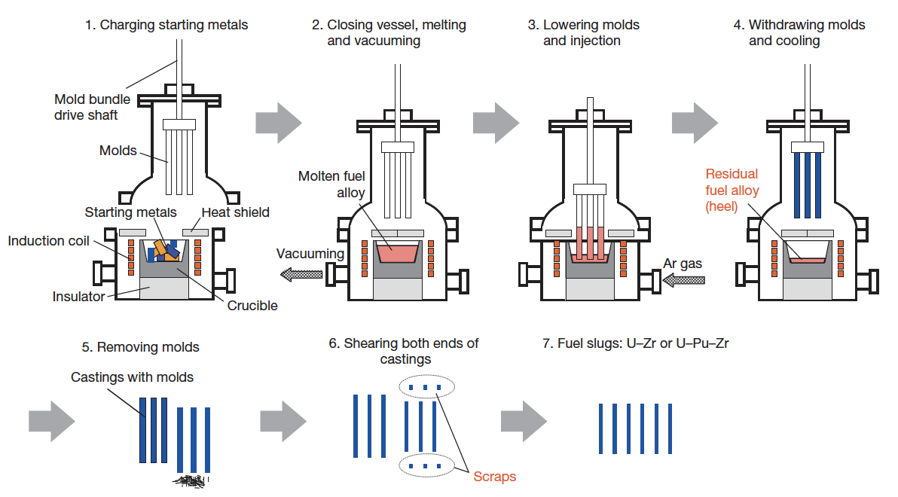
Metal Fuel Fabrication
Injection casting has been utilized for fuel slug fabrication
Remote fabrication has been performed inside a hot cell on recovered uranium
Fuel slugs for EBR II and FFTF were fabricated via injection casting

Slide 19
Metal Fuel Fabrication
Starting materials are charged into the graphite crucible in the furnace
Silica molds with tops closed are set above the crucible
Crucible is coated with yttria
Molds coated with zirconia

Slide 20
Metal Fuel Fabrication
Furnace closed and filled with Ar gas
Crucible is inductively heated to 1830K, and stirred electromagnetically
Ar gas removed, molds are lowered, then Ar gas returned
Pressure difference injects the melt into the molds

Slide 21
Issues
Injection casting leads to lots of waste
  A large ‘heel’ is required because if the open end of the quartz mold is exposed, gas is drawn in and creates voids
  This heel needs to be recycled, and lowers melt utilization
Single use molds
  Molds are quartz and need to be broken each time, and are then categorized as radioactive waste
Vaporization issues
  More critical with MA-bearing fuels, where Pu and Am have high vapor pressures; can lead to loss of up to 40% of Am inventory in the fuel
Over 100K pins have been made, but different fabrication pathways are being explored

Slide 22
Closing the Fuel Cycle
An important factor in selecting a fuel form for fast reactors is ease of fuel recycling, including reprocessing and fuel refabrication
Pyrometallurgical processing, called ‘melt refining,’ can be combined with refining techniques to recycle spent metallic fuel
This recycling process has been demonstrated for uranium alloy fuels in the 1960s, where fuel alloys were recycled as many as four times, and the fuel was returned to the reactor within 4–6 weeks of its removal from the reactor core

Slide 23
Reprocessing
Pyroprocessing
For more than 50 years, pyrometallurgy has been studied as an alternative strategy in the reprocessing of used fuel
Pyrochemical processes rely on refining techniques at high temperature (500–900 C) depending on the molten salt eutectic used
Typically, chloride systems operate at lower temperature compared to fluoride systems, and are preferred in processing
These processes are mainly based on electrorefining or on extraction from the molten salt phase into liquid metal
Two processes-one for oxide fuel and one for metallic fuel-have been developed to near industrial scale

Slide 24
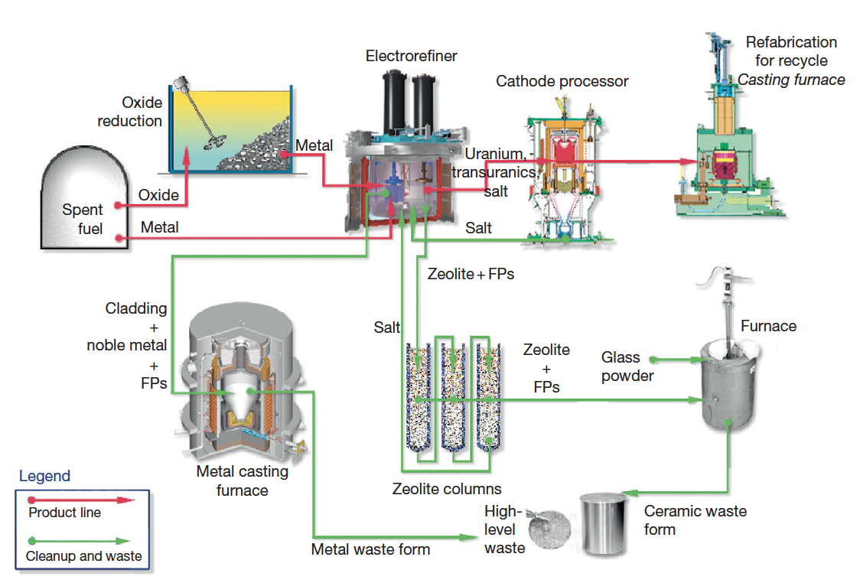
IFR Pyroprocess
This process was developed in the US to be part of the IFR project, and can handle the treatment of transuranics
The fuel is recycled using an electrochemical process based on molten chloride salts and liquid metals
The molten salt medium for electrorefining is a solution of a certain amount of UCl3 dissolved in a LiCl–KCl eutectic

Slide 25
IFR Pyroprocess
The fuel is electrochemically dissolved using a potential between the basket (loaded with used fuel) as anode and a stainless steel electrode in the salt as the cathode
Uranium and TRU are deposited on the cathodes
Once the fuel is dissolved and most of the uranium is deposited on the solid steel, this cathode is replaced by a liquid cadmium cathode, and the remaining TRUs can be co-deposited with the remaining uranium

Slide 26
IFR Pyroprocess
The alkali, alkaline earth, rare earth, and halide FPs remain primarily dissolved in the salt phase
More than 90% of the noble metal FPs and fuel alloy material are retained in the chopped fuel cladding segments in the anode baskets
Can reduce the repository burden of radioactive waste by separating long-lived MA from spent fuel, burning MA in fast reactors, and decreasing the long-term radioactivity of nuclear waste

Slide 27
Refabrication
Metal-fueled fast reactors facilitate the effective transmutation of MA because of the high-energy neutron spectrum
One of the measures to load MA into the reactor core is to add MA to the fuel alloy homogeneously
Can perform injection casting in the same manner as the fresh fuel, to form MA-bearing fuel alloys
These technologies are expected to reduce the fuel cycle cost even for small-scale fuel cycle plants because of the simplicity of the process and the compactness of the equipment
For example, in the injection casting process, composition adjustment, melting (alloying), and casting of the fuel slug can be done in a single injection-casting furnace

Slide 28
Mixed oxide fuel

Slide 29
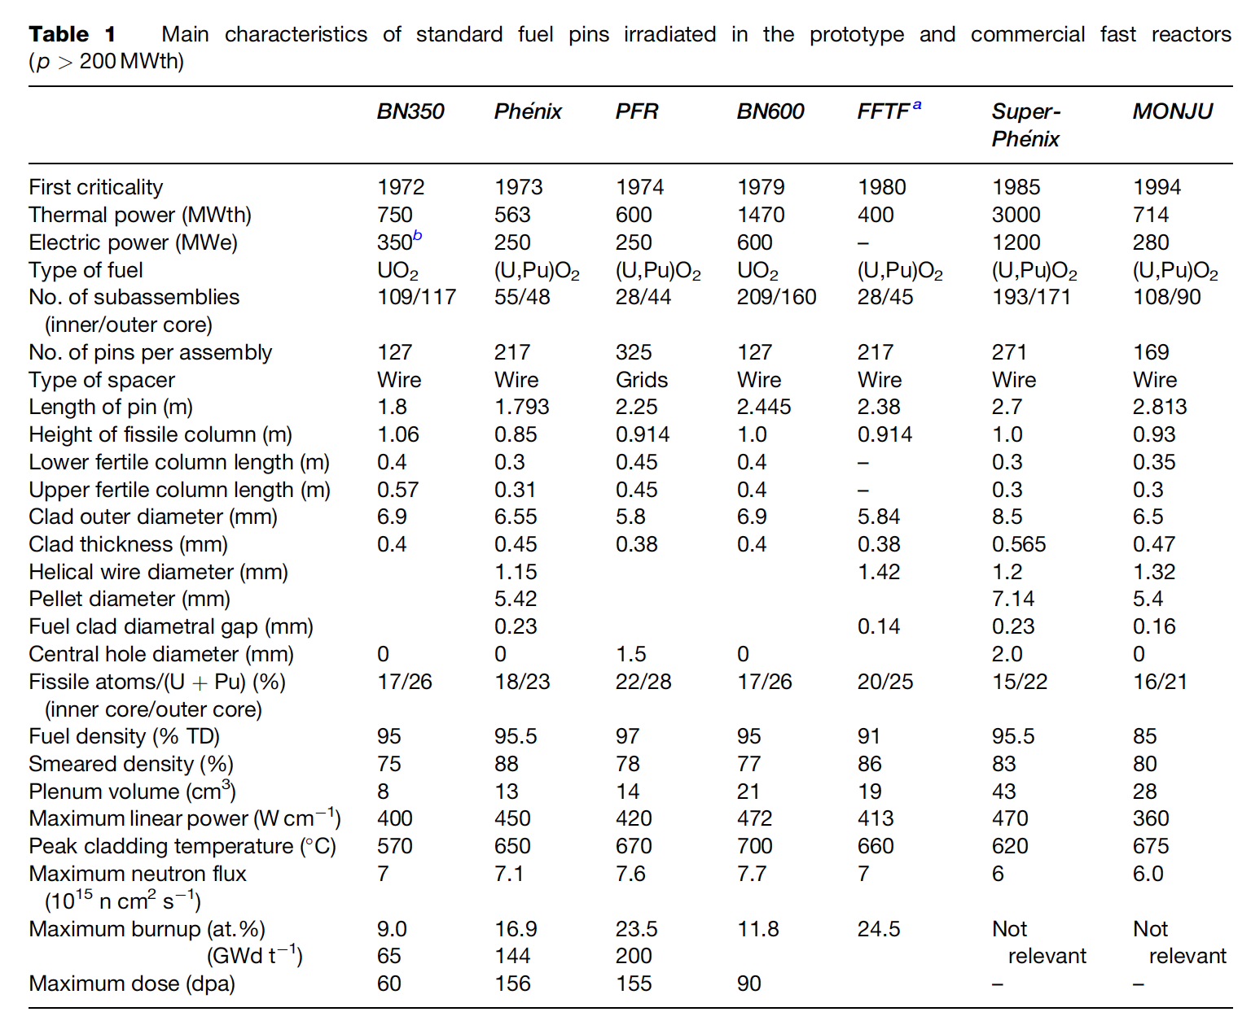
MOX Introduction
Despite some disadvantages, such as its low U density, poor thermal conductivity, and its chemical reaction with sodium, MOX fuel (U,Pu)O2 is the fuel that has been used most in fast reactors
In order to avoid the dramatic swelling of metallic fuels, MOX fuels were explored in fast reactors
Behavior was observed to be satisfactory and was relatively widely implemented in SFRs

Slide 30
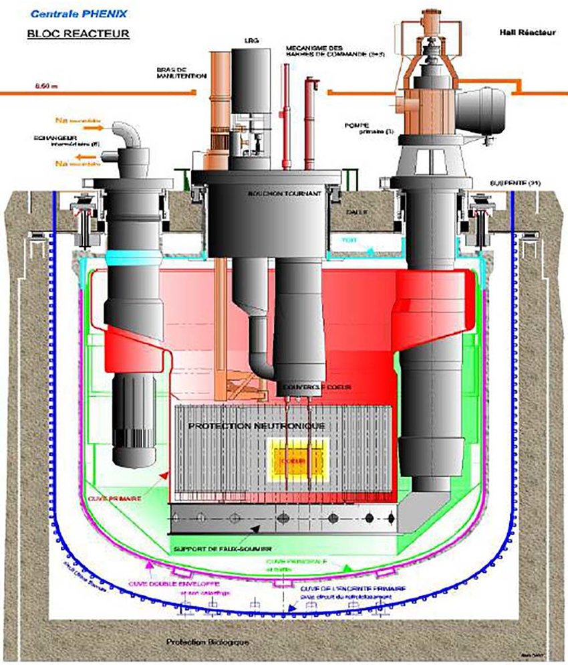
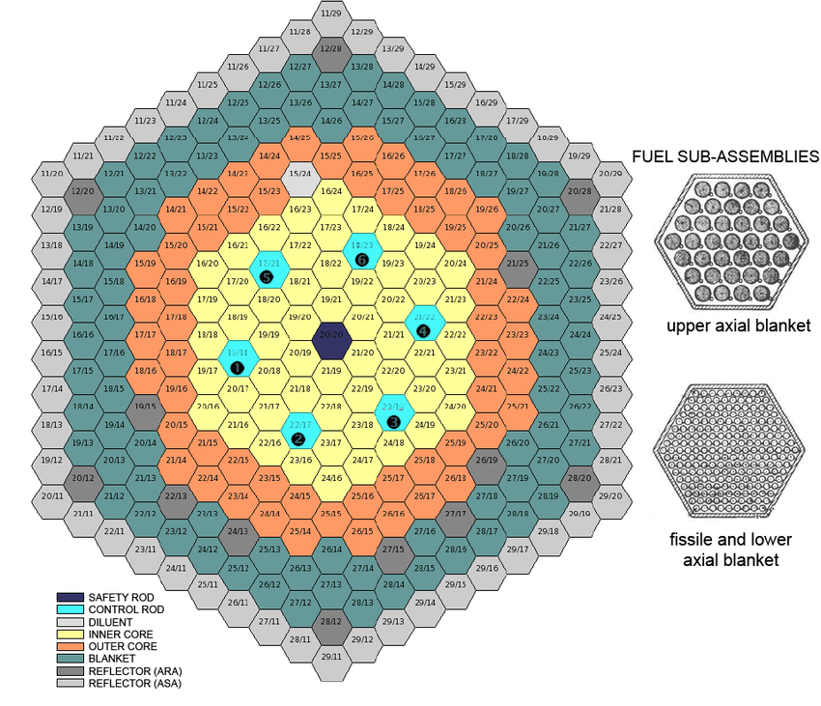
MOX Fuel Design
Typical fuel pin is 2-3 m long, with MOX pellets stacked 1 m with a plenum above and below the fueled zone
He bond, steel cladding
Hexagonal core and hexagonal assemblies
Each assembly contains 100-200 fuel pins
Schematics are from Phenix reactor

Slide 31
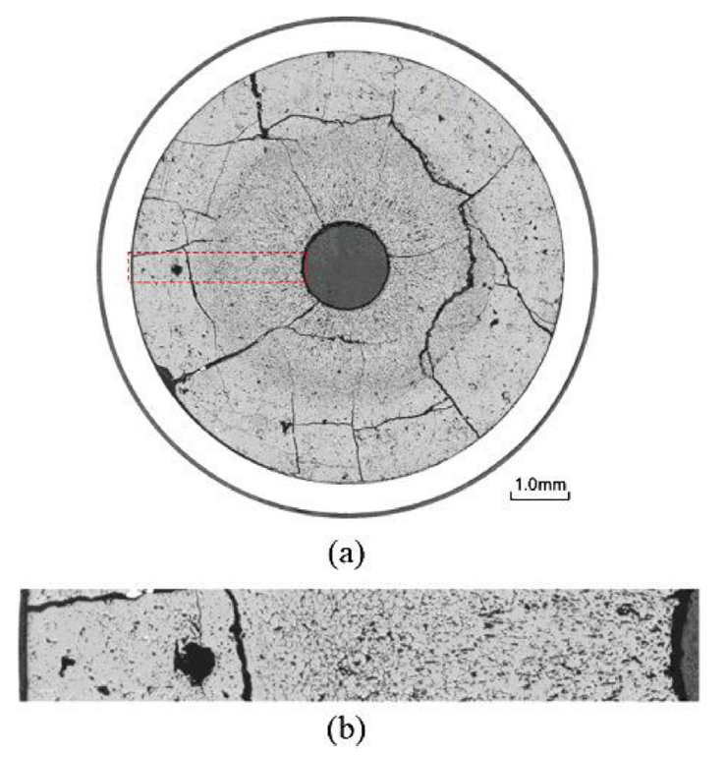
MOX Fuels in SFRs
MOX fuel operates at linear heating rates that are 2X higher than LWR fuels (450 W/cm)
MOX will run at higher temperatures than LWR fuel, and thus with different properties
Fission product phases and evolving microstructures create highly localized properties that can differ significantly from the bulk fuel
Stoichiometry and Pu content are important factors that dictate thermal properties

Slide 32
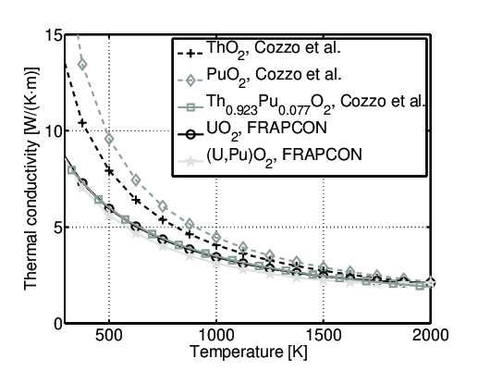
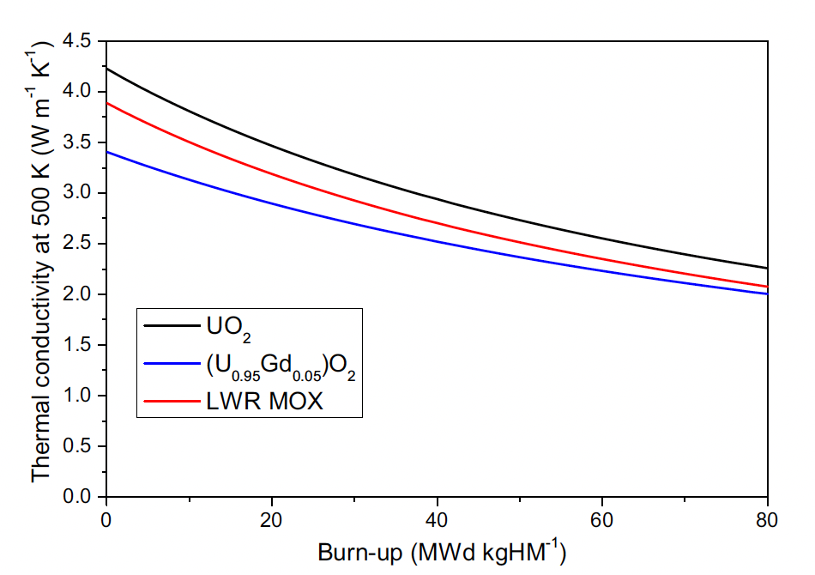
Thermal Properties
Because we have higher temperatures, knowledge of the thermal field is critical
Thermal conductivity is similar to UO2, transport via phonons
Porosity, off-stoichiometry, fission products, etc., cause scattering and degrade k, metallic precipitates increase k
The mixed oxide typically has worse conductivity than either pure oxide
Degrades with burnup
Various models have been developed to describe the degradation

Slide 33
MOX Restructuring
Oxide nuclear fuels are commonly touted for their outstanding high temperature capabilities under irradiation, but this stability comes with the tradeoff of low thermal conductivity
Due to the low thermal transport, a steep temperature gradient is formed along the radius of the fuel pellet, with the hottest region at the center of the pellet and coolest near the cladding
This leads to grain growth and restructuring
Pu bearing fast reactor oxide fuels display four defining regions of a restructured pellet:
  the central void, the columnar grain growth region, the equiaxed grain growth region, and the as-sintered region
The higher temperatures and heating rates form coarse, elongated grains that grow radially toward the outer rim of the fuel

Slide 34
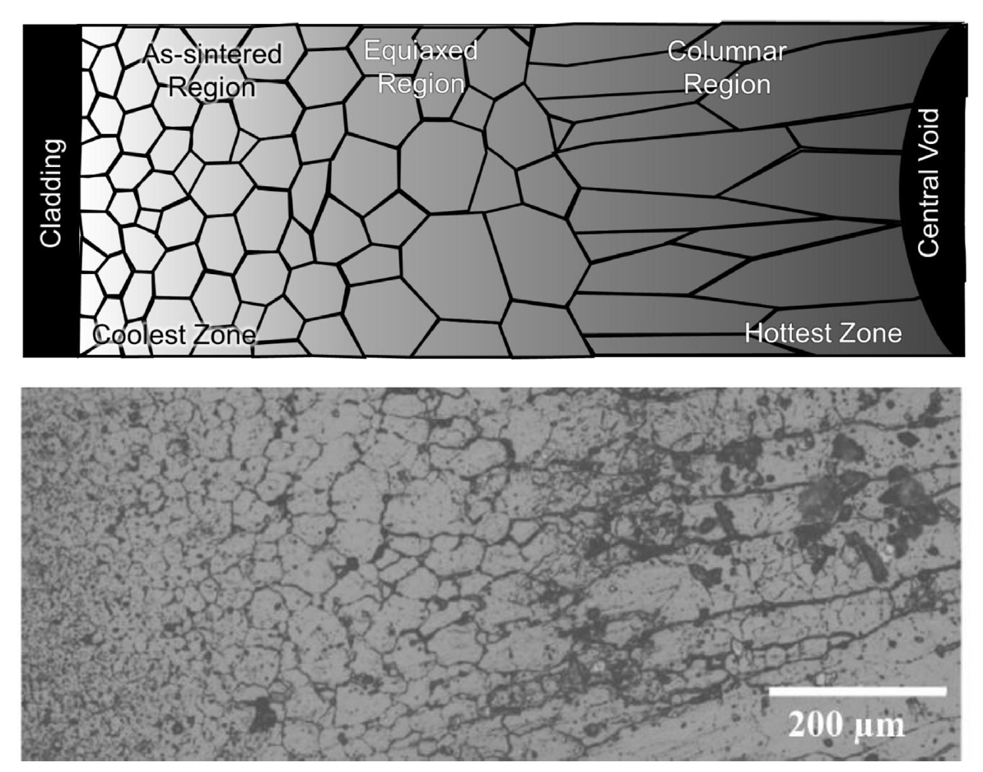
MOX Restructuring
The equiaxed region consists of grains that have undergone significant growth when compared to the un-irradiated samples
Central voids have been shown to appear in irradiation times as short as 10 min, demonstrating that the appearance the central void is a result of fuel temperature and linear heating rate, not high burnup
The central void forms from the accumulation of voids and pores present in the fuel along a thermal gradient

Slide 35
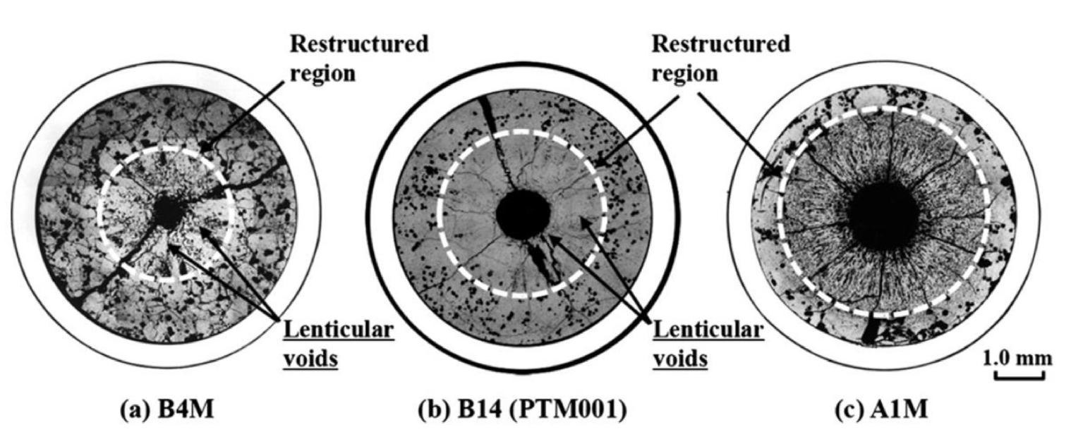
MOX Pore Formation
Heating Rate

Slide 36
MOX Pore Formation
The smallest spherical pores are highly mobile, being able to quickly and easily move through the restructured region
Intermediate sized pores become flat and elongated as they travel towards the fuel centers, leaving streaks at the tips of the voids as they travel
These “lenticular” voids are the most readily identifiable porosity feature in the irradiated MOX fuels due to their distinct shape

Slide 37
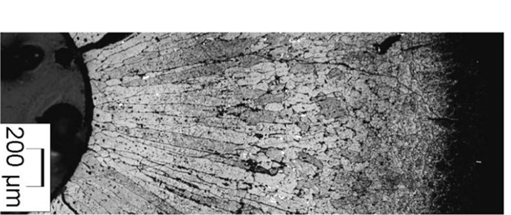
Pore Migration
Hot to cold side of the pores has a steeper temperature gradient than in the fuel
The pressure of the fuel vapor is higher on the hot side of the lenticular pore, which induces an evaporation–condensation mechanism
Matter evaporates from the hot face and condenses on the cold face
Induces an inverse displacement of the lenticular pores that climb the thermal gradient toward the center of the pellet
The oxide vapor condenses on the cold side in a nearly single crystal way
The lenticular pores destroy the initial fuel microstructure and leave behind very elongated ‘columnar grains’ that appear clearly in micrographs

Slide 38
MOX Restructuring
The velocity of the pores varies rapidly with temperature, and the columnar grains only form at temperatures above ~1800C
Below 1800C, an equiaxed region consists of grains that have undergone significant growth when compared to the un-irradiated samples
At the periphery of the fuel pellet, temperatures are sufficiently low to limit grain growth, and thus the microstructure doesn’t undergo rapid changes

